Slide 1
Pitch Deck Template
Make a copy of this deck.
Do NOT add or remove any slides
Don’t forget to click on ‘Share’ and set ‘General Access’ to anyone with the link can view

Slide 2

Sign-to-Speech Technology
Team:-Futureforge

Slide 3
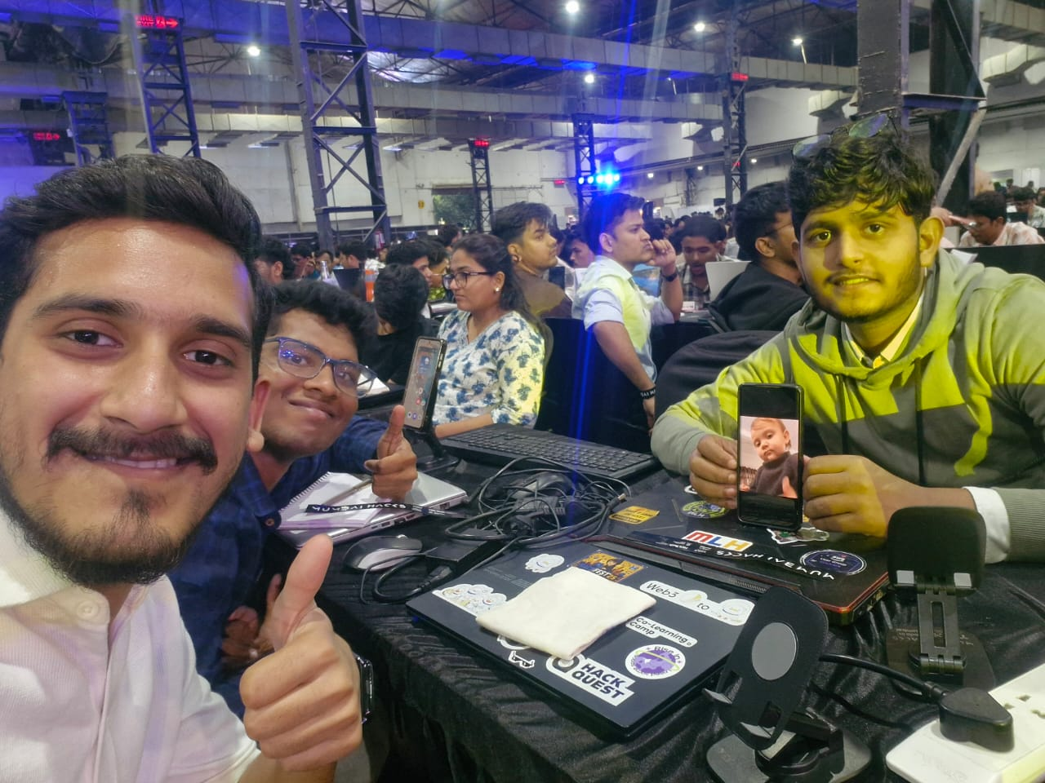
A picture of your team!
Anubhav Gupta | Abhinash Ray | Ayush Agarwal | Team Member Name

Slide 4
Problem Statement
Technology Overview
  Sign-to-Speech uses AI, computer vision, and NLP to convert sign language gestures into spoken words.
Real-Time Interaction
  This technology enables seamless real-time communication between sign language users and speakers.
Inclusivity and Empowerment
  Sign-to-Speech empowers hearing or speech-impaired individuals to engage fully in social and professional settings.
Technical Process
  The system captures gestures via cameras, processes them with machine learning, and generates spoken output.

Slide 5
Solution
Gesture Recognition
  Cameras and wearable sensors capture hand movements, facial expressions, and body posture for sign detection.
Machine Learning Interpretation
  Machine learning models map recognized gestures to words or phrases in spoken language.
Natural Language Processing
  Ensures grammatical accuracy and contextual relevance in the translated text output.
Speech Synthesis
  Converts interpreted text into audible speech, completing the communication loop in real-time.

Slide 6
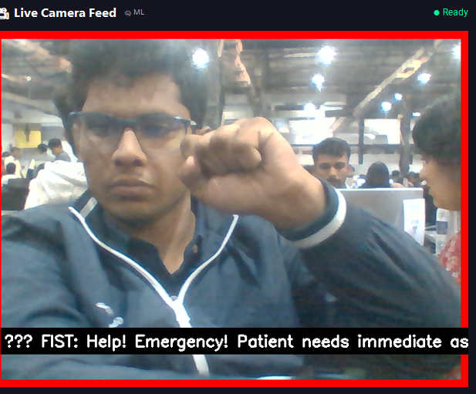
Screenshot 1

Slide 7
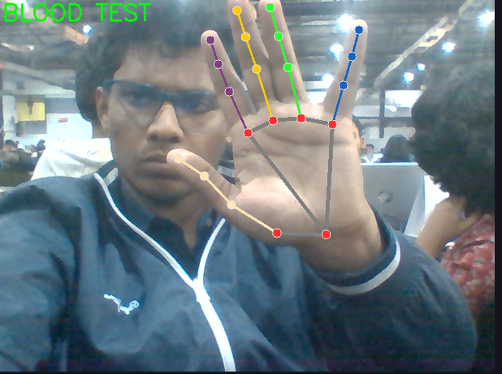
Screenshot 2

Slide 8
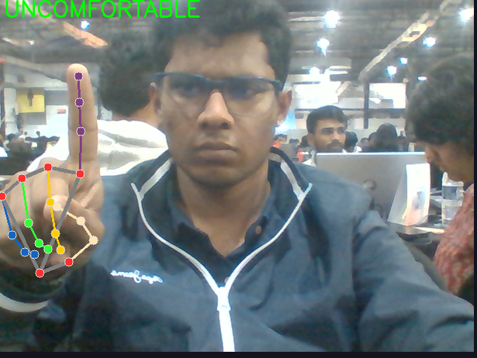
Screenshot 3

Slide 9
Business Model
Revenue Streams
a) Subscription Model
₹199–₹499/month for individual users
Premium voice packs, unlimited translations, offline mode
b) Institutional Licenses
Schools / hospitals / companies: ₹20,000–₹1,50,000 per year depending on size
Training + admin dashboard included
c) API / SaaS Integration
API billed per 1,000 translations
Integration for EdTech apps, telemedicine, help centers

Slide 10
Anything else?
Immersive AR and VR Integration
  Integrating Sign-to-Speech with AR and VR creates immersive, seamless communication in virtual environments.
Multilingual Sign Translation
  Future systems will translate sign language into multiple spoken languages for broader global use.
Wearable Technology Advances
  Smart gloves and AR glasses will enhance portability and affordability of Sign-to-Speech devices.
AI Accuracy and Adaptability
  Improved AI algorithms will boost accuracy and adaptability in diverse and challenging environments.

Slide 11
Thank you
One line about your favorite
part of MumbaiHacks 2025!

